Slide 1
Logical Agents
CH 7
Slides based in part on material from Andrea Thomaz and Maithilee Kunda

Slide 2

Overview
Reflex agents
very little knowledge
Goal-based agents
specific kind of knowledge (transition model, heuristics, ...)
Knowledge-based agents
more generic kind of knowledge, and generic ways to combine == more flexible agents

Slide 3
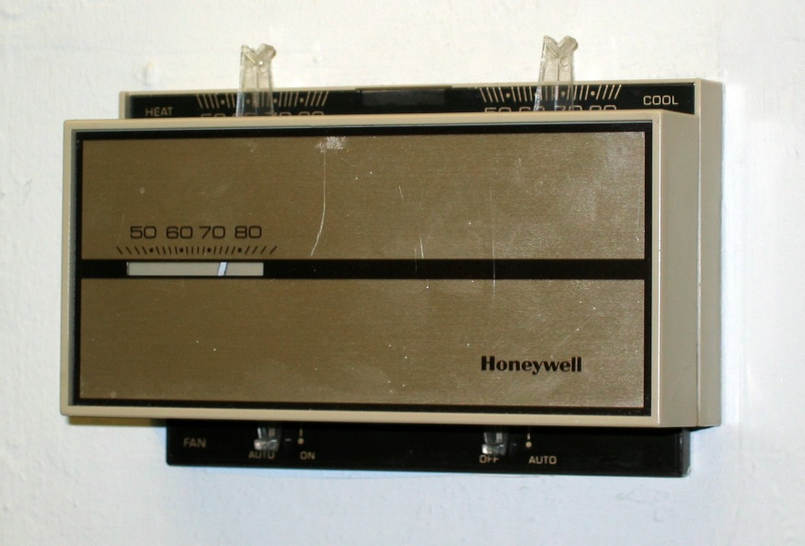
Overview
Reflex agents
very little knowledge
Goal-based agents
specific kind of knowledge (transition model, heuristics, ...)
Knowledge-based agents
more generic kind of knowledge, and generic ways to combine == more flexible agents

Slide 4
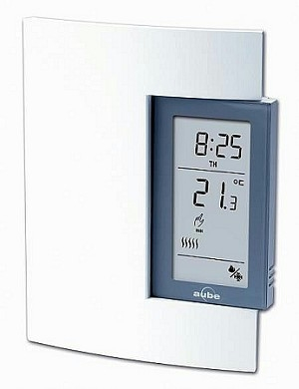
Overview
Reflex agents
very little knowledge
Goal-based agents
specific kind of knowledge (transition model, heuristics, ...)
Knowledge-based agents
more generic kind of knowledge, and generic ways to combine == more flexible agents

Slide 5
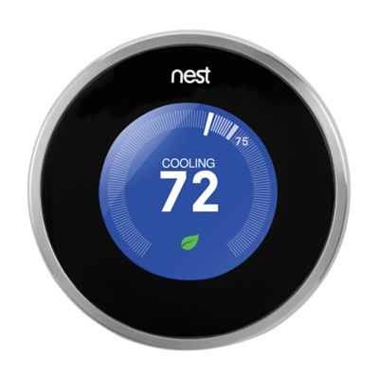
Overview
Reflex agents
very little knowledge
Goal-based agents
specific kind of knowledge (transition model, heuristics, ...)
Knowledge-based agents
more generic kind of knowledge, and generic ways to combine == more flexible agents

Slide 6
Overview
Intro basic Logical Agent Design
Wumpus World -- example environment
Concepts of Logic in General
Propositional Logic
First-order Logic
Inferences with FOL
Today and Mon

Slide 7
Knowledge-Based Agent Design

Slide 8


Knowledge Base (KB)
List of sentences, assertions about the world
S1
S2
…
…
Sn
Tell:
Add new sentences to the KB
Ask:
Answer some query based on current facts of the KB

Slide 9
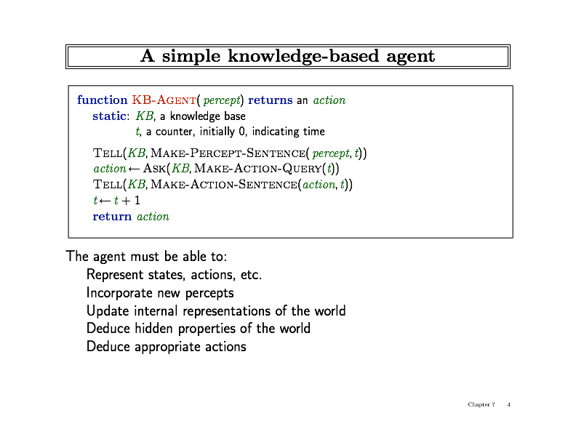
Simple KB-agent

Slide 10
Simple KB-agent
This is the big idea!

Slide 11
Logic Domain:
The Wumpus World

Slide 12
System of caves and passageways
There is a wumpus! It will eat you.
You have only one arrow.
There are bottomless pits.
There is gold.

Slide 13
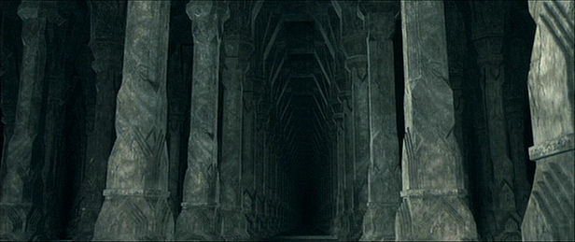
System of caves and passageways
There is a wumpus! It will eat you.
You have only one arrow.
There are bottomless pits.
There is gold.

Slide 14
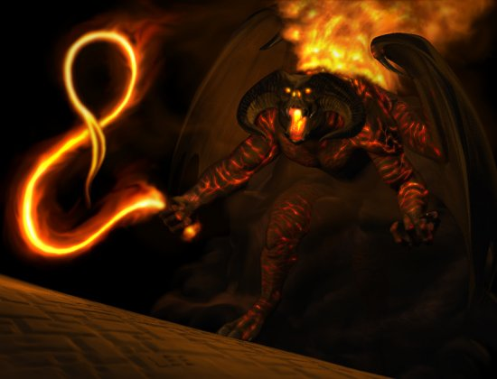
System of caves and passageways
There is a wumpus! It will eat you.
You have only one arrow.
There are bottomless pits.
There is gold.

Slide 15
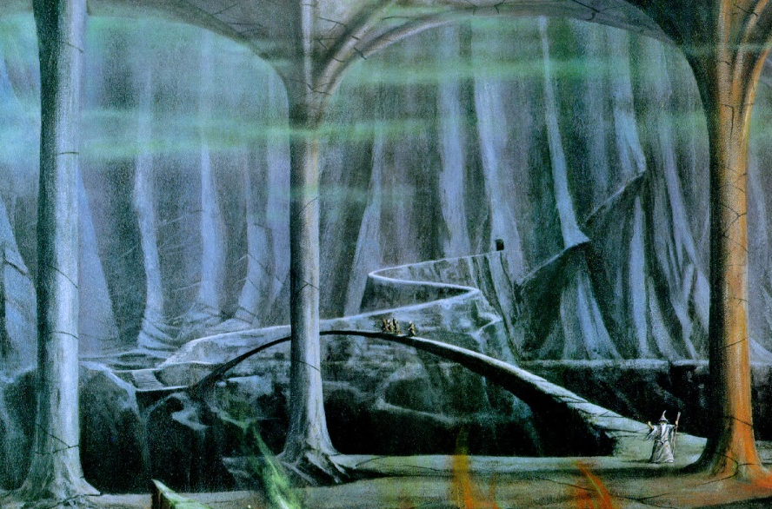
System of caves and passageways
There is a wumpus! It will eat you.
You have only one arrow.
There are bottomless pits.
There is gold.

Slide 16
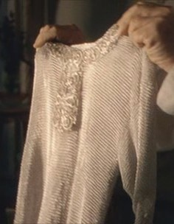
System of caves and passageways
There is a wumpus! It will eat you.
You have only one arrow.
There are bottomless pits.
There is gold.

Slide 17
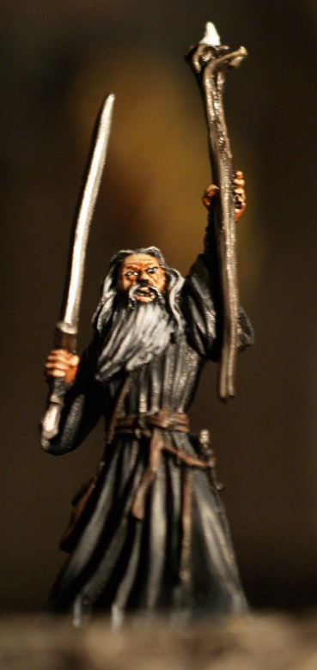
System of caves and passageways
There is a wumpus! It will eat you.
You have only one arrow. wizard.
There are bottomless pits.
There is gold.

Slide 18
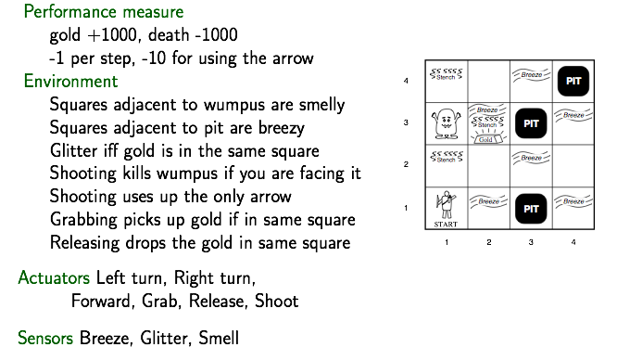
Wumpus World (PEAS)

Slide 19
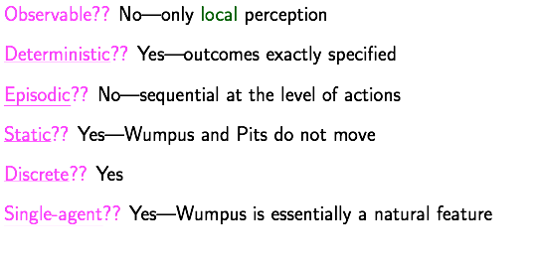
Wumpus World

Slide 20
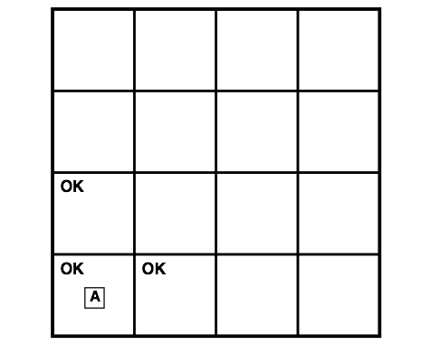
Exploring in Wumpus World
i=1
2
3
4
4
3
2
j=1

Slide 21
Exploring in Wumpus World
i=1
2
3
4
4
3
2
j=1
Percept [1,1]: None
Action: Forward to [1,2]

Slide 22
Exploring in Wumpus World
i=1
2
3
4
4
3
2
j=1
Percept [1,1]: None
Action: Forward to [1,2]

Slide 23
Exploring in Wumpus World
i=1
2
3
4
4
3
2
j=1
Percept [1,1]: None
Action: Forward to [1,2]

Slide 24
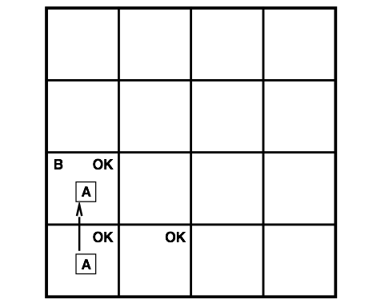
Exploring in Wumpus World
i=1
2
3
4
4
3
2
j=1
Percept [1,2]: Breeze

Slide 25
Exploring in Wumpus World
i=1
2
3
4
4
3
2
j=1
Percept [1,2]: Breeze

Slide 26

Exploring in Wumpus World
i=1
2
3
4
4
3
2
j=1
Percept [1,2]: Breeze; Pit in [1,3] or [2,2]
Action: turn back, go to [2,1]

Slide 27
Exploring in Wumpus World
i=1
2
3
4
4
3
2
j=1
Percept [1,2]: Breeze; Pit in [1,3] or [2,2]
Action: turn back, go to [2,1]

Slide 28
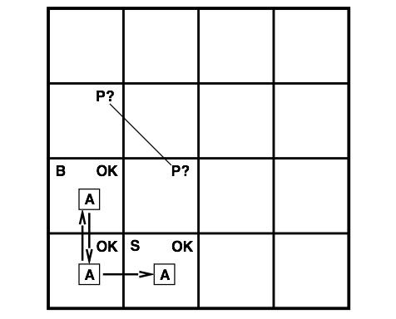
Exploring in Wumpus World
i=1
2
3
4
4
3
2
j=1

Slide 29
Exploring in Wumpus World
i=1
2
3
4
4
3
2
j=1
Percept [2,1]: Smelly;

Slide 30

Exploring in Wumpus World
i=1
2
3
4
4
3
2
j=1
Percept [2,1]: Smelly; W in [3,1] & [2,2] is OK

Slide 31
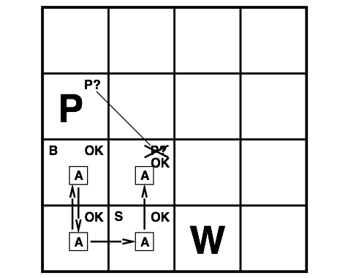
Exploring in Wumpus World
i=1
2
3
4
4
3
2
j=1
Percept [2,1]: Smelly; W in [3,1] & [2,2] is OK
Action: goto [2,2]

Slide 32

Exploring in Wumpus World
i=1
2
3
4
4
3
2
j=1

Slide 33
Exploring in Wumpus World
i=1
2
3
4
4
3
2
j=1
Percept [2,2]: None

Slide 34
Exploring in Wumpus World
i=1
2
3
4
4
3
2
j=1
Percept [2,2]: None; [2,3] & [3,2] ok

Slide 35
Exploring in Wumpus World
i=1
2
3
4
4
3
2
j=1
Percept [2,2]: None; [2,3] & [3,2] ok
Action: goto [3,2]

Slide 36
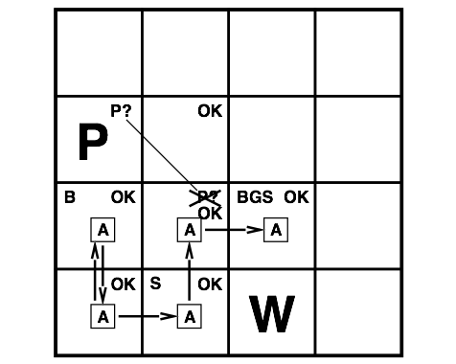
Exploring in Wumpus World
i=1
2
3
4
4
3
2
j=1

Slide 37
Exploring in Wumpus World
i=1
2
3
4
4
3
2
j=1
Percept [3,2]: Breeze, Glitter, Smelly

Slide 38
Exploring in Wumpus World
i=1
2
3
4
4
3
2
j=1
Percept [3,2]: Breeze, Glitter, Smelly
Action: grab gold!

Slide 39
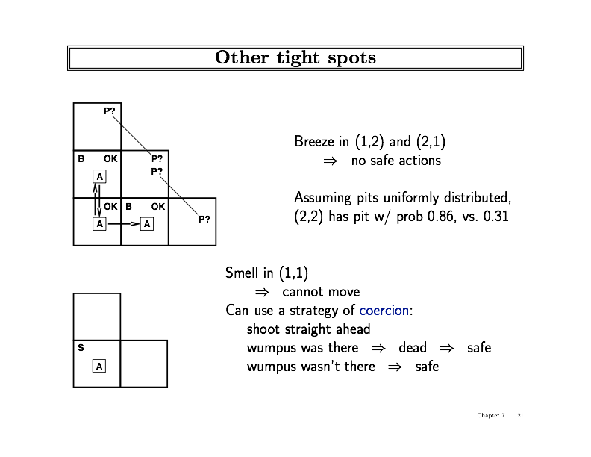
Harder Decisions

Slide 40
Harder Decisions

Slide 41
Logic in General
Representation & Reasoning

Slide 42
Logic In General
Logics: formal languages for representing information s.t. conclusions can be drawn
Syntax: defines sentences in the language
Semantics: defines meaning of sentence (defines truth of a sentence in a world)

Slide 43
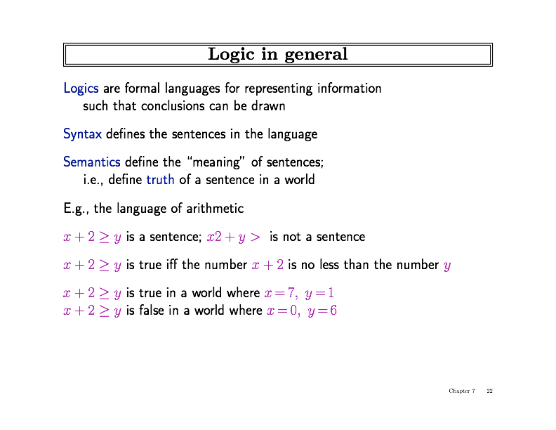
Logic In General

Slide 44
Logic In General

Slide 45
Logic In General

Slide 46
Logic In General

Slide 47
Logic In General
Particular instantiation of variables, a possible world, is called a model

Slide 48
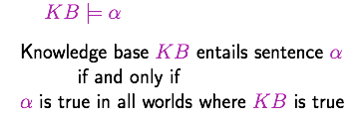
Entailment
Entailment: one thing follows from another
Example, KB with sentence: “x+y=4”
entails sentence: “4=x+y”
and sentence: “y=4-x”

Slide 49
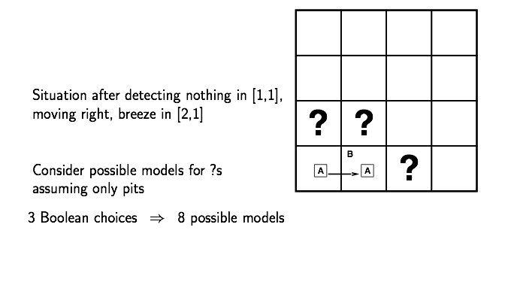
Entailment in Wumpus

Slide 50
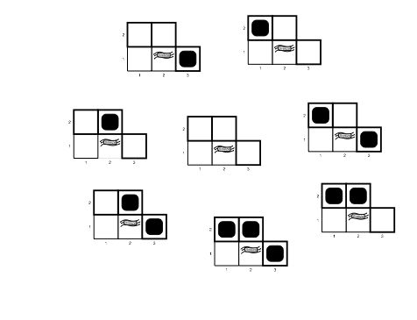
Entailment in Wumpus

Slide 51
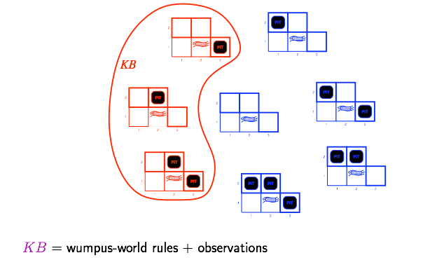
Wumpus Models
These models are consistent with the rules and our percepts so far
These models don’t agree with the rules about “Breezes”

Slide 52
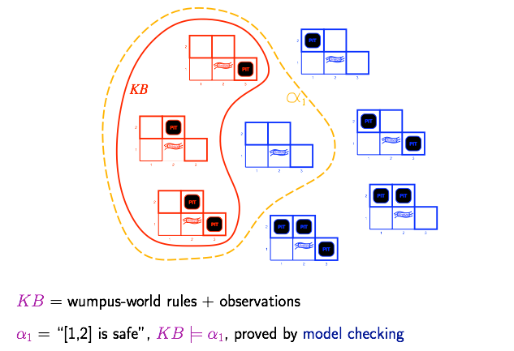
Model Checking
Find all models where query is true…check if KB is within this set
Conclude:
sentence can be added to the KB
Notes:
Note: M(\alpha_1) is the set of worlds in which \alpha_1 is true (all worlds inside the dashed yellow line). M(KB) is all the worlds in which KB is true (all worlds inside red line). The statement KB entails \alpha_1 is equivalent to saying that M(KB) is a subset of M(\alpha_1). Because in every world in which KB is true, \alpha_1 also must be true. See p. 242 in your book.

Slide 53

Model Checking
Find all models where query is true…check if KB is within this set

Slide 54
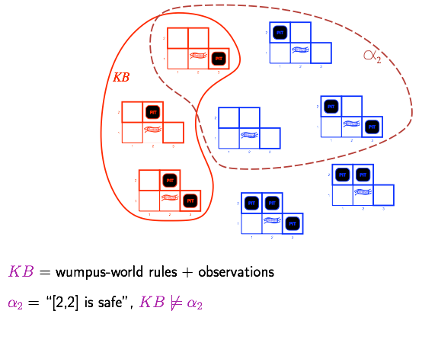
Model Checking
Find all models where query is true…check if KB is within this set
Conclude:
sentence not consistent with the KB

Slide 55
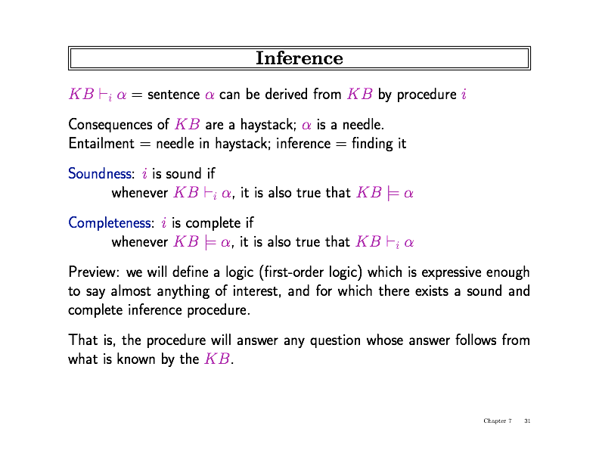
Inference

Slide 56
Inference

Slide 57
Inference

Slide 58
Inference

Slide 59
Inference

Slide 60
Questions?

Slide 61
Extra: The logical agent called YOU
Notes:
The remaining slides are due to Maithilee Kunda, based on the classical Wason Selection Task (from 1966)

Slide 62
Extra: The logical agent called YOU
Imagine that you are the quality control technician at a factory that prints cards that are used in signaling exercises.
You see cards coming down the conveyor belt and you have to turn them over to check whether they follow a certain rule.

Slide 63
If a card has a circle on one side, then it has the color yellow on the other side.

Slide 64




If a card has a circle on one side, then it has the color yellow on the other side.

Slide 65
You got laid off. But, you managed to get a new job at a local bar as the bouncer.
You see people, and you see drinks, and your job is to make sure that everyone is following the law.

Slide 66
If a person drinks an alcoholic drink, then they must be over the age of 21 years old.

Slide 67




If a person drinks an alcoholic drink, then they must be over the age of 21 years old.

Slide 68
If a card has a circle on one side, then it has the color yellow on the other side.

Slide 69
If a card has a circle on one side, then it has the color yellow on the other side.

Slide 70
If a person drinks an alcoholic drink, then they must be over the age of 21 years old.

Slide 71
If a person drinks an alcoholic drink, then they must be over the age of 21 years old.

Slide 72
Why?

Slide 73
Why?
This task is called the Wason Selection Task.

